Slide 1
Information Retrieval
Dr. Maheswari Karthikeyan

Slide 2
Lecture Outline
Tolerant Retrieval
Spelling Correction
Phonetic Correction

Slide 3
Weighted edit distance
Sec. 3.3.3
As above, but the weight of an operation depends on the character(s) involved
Meant to capture OCR or keyboard errors Example: m more likely to be mis-typed as n than as q
Therefore, replacing m by n is a smaller edit distance than by q
This may be formulated as a probability model
Requires weight matrix as input
Modify dynamic programming to handle weights

Slide 4
k-gram index
Enumerate all k-grams in the query term
Example: bigram index, misspelled word bordroom
Bigrams: bo, or, rd, dr, ro, oo, om
Use the k-gram index to retrieve vocabulary terms that have many k-grams in common with the query
4

Slide 5
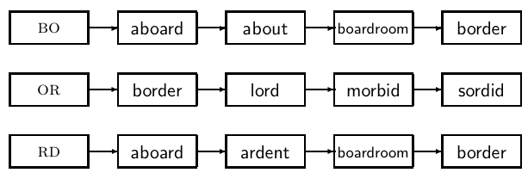
k-gram index
5

Slide 6
Context-sensitive spell correction
Take the Example : flew form munich
How can we correct form here?
One idea: hit-based spelling correction
Retrieve “correct” terms close to each query term for "flew form munich":
flea for flew, from for form, munch for munich
Now try all possible resulting phrases as queries with one word “fixed” at a time
Try query “flea form munich”
Try query “flew from munich”
Try query “flew form munch”
The correct query “flew from munich” has the most hits.
Not efficient. Better source of information: large corpus of queries,not documents
6

Slide 7
Phonetic correction
Misspellings that arise because the user types a query that sounds like the target term.
The main idea here is to generate, for each term, a “phonetic hash” so that similar-sounding terms hash to the same value.
Algorithms for such phonetic hashing are collectively known as soundex algorithms

Slide 8
Soundex
Sec. 3.4
Class of heuristics to expand a query into phonetic equivalents
Language specific – mainly for names
E.g., chebyshev → tchebycheff
Invented for the U.S. census … in 1918

Slide 9
Soundex – algorithm
Sec. 3.4
Turn every token to be indexed into a 4-character reduced form. Build an inverted index from these reduced forms to the original terms; call this the soundex index.
Do the same with query terms
When the query calls for a soundex match, search this soundex index.

Slide 10
Soundex – algorithm
Sec. 3.4
Retain the first letter of the word.
Change all occurrences of the following letters to '0' (zero): 'A', E', 'I', 'O', 'U', 'H', 'W', 'Y'.
Change letters to digits as follows:
B, F, P, V → 1
C, G, J, K, Q, S, X, Z → 2
D,T → 3
L → 4
M, N → 5
R → 6

Slide 11
Sec. 3.4
Soundex – algorithm
Remove all pairs of consecutive digits.
Remove all zeros from the resulting string.
Pad the resulting string with trailing zeros and return the first four positions, which will be of the form <uppercase letter> <digit> <digit> <digit>.

Slide 12
Soundex
Sec. 3.4
Soundex is the classic algorithm, provided by most databases (Oracle, Microsoft, …)
Not much useful for information retrieval
Okay for “high recall” tasks (e.g., Interpol), though biased to names of certain nationalities

Slide 13
Thank You!

